Slide 1
API Requests and Responses
Front-End Web Development

Slide 2
Pre-Class Materials and Preparation
Review all slides, lab activities, and code-alongs.
There are prompts in the speaker notes with opportunities for instructor customization.
Materials:
Reference Code
Starter Code in CodePen
Solution Code in CodePen

Slide 3
API Calls and Response Handling
Overview
This lesson introduces HTML forms and how JS can be used to collect and validate information from users.
Learning Objectives
In this lesson, students will:
Make HTTP requests to external API sources for data.
Evaluate APIs based on documentation.
Use API responses to update HTML content.
Duration: 180 minutes

Slide 4
Suggested Agenda
Time | Activity | Purpose
0:00–0:30 | What Are APIs/ Weather API Demo | Introduce APIs and demonstrate with a simple weather-fetching app.
1:00–1:30 | Evaluating and Using APIs | Give students some idea of how to tell good APIs from bad ones.
1:30–3:00 | Giphy Bank | Uses the Giphy API to create a fun GIF-searching app; could also incorporate flexbox/Grid to layout the results.

Slide 5
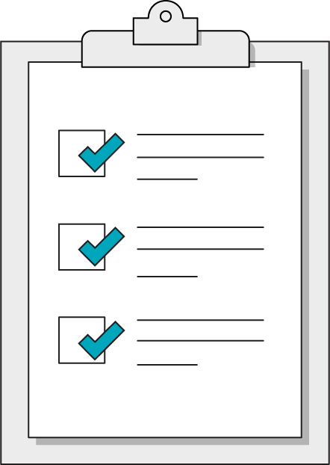
Today’s Learning Objectives
In this lesson, you will:
Make HTTP requests to external API sources for data.
Evaluate APIs based on documentation.
Use API responses to update HTML content.
‹#› | © 2020 General Assembly
Notes:
DURATION: 1 minute
TEACHING TIPS:
Learning objectives help frame the lesson and give students an idea of what to expect and focus on.
Explain to students how this lesson fits into the overall course to help them make connections with content from other lessons.

Slide 6
What Are APIs?
Front-End Web Development
Notes:
TALKING POINTS:
Many websites show their users information from third-party sources. Thanks to APIs, you can use JavaScript to request and use information from all across the web — whether it’s a weather report, a stock price, or the latest news headlines.
It’s time for our websites to become full-fledged citizens of the internet by interacting with other applications through AJAX requests!

Slide 7
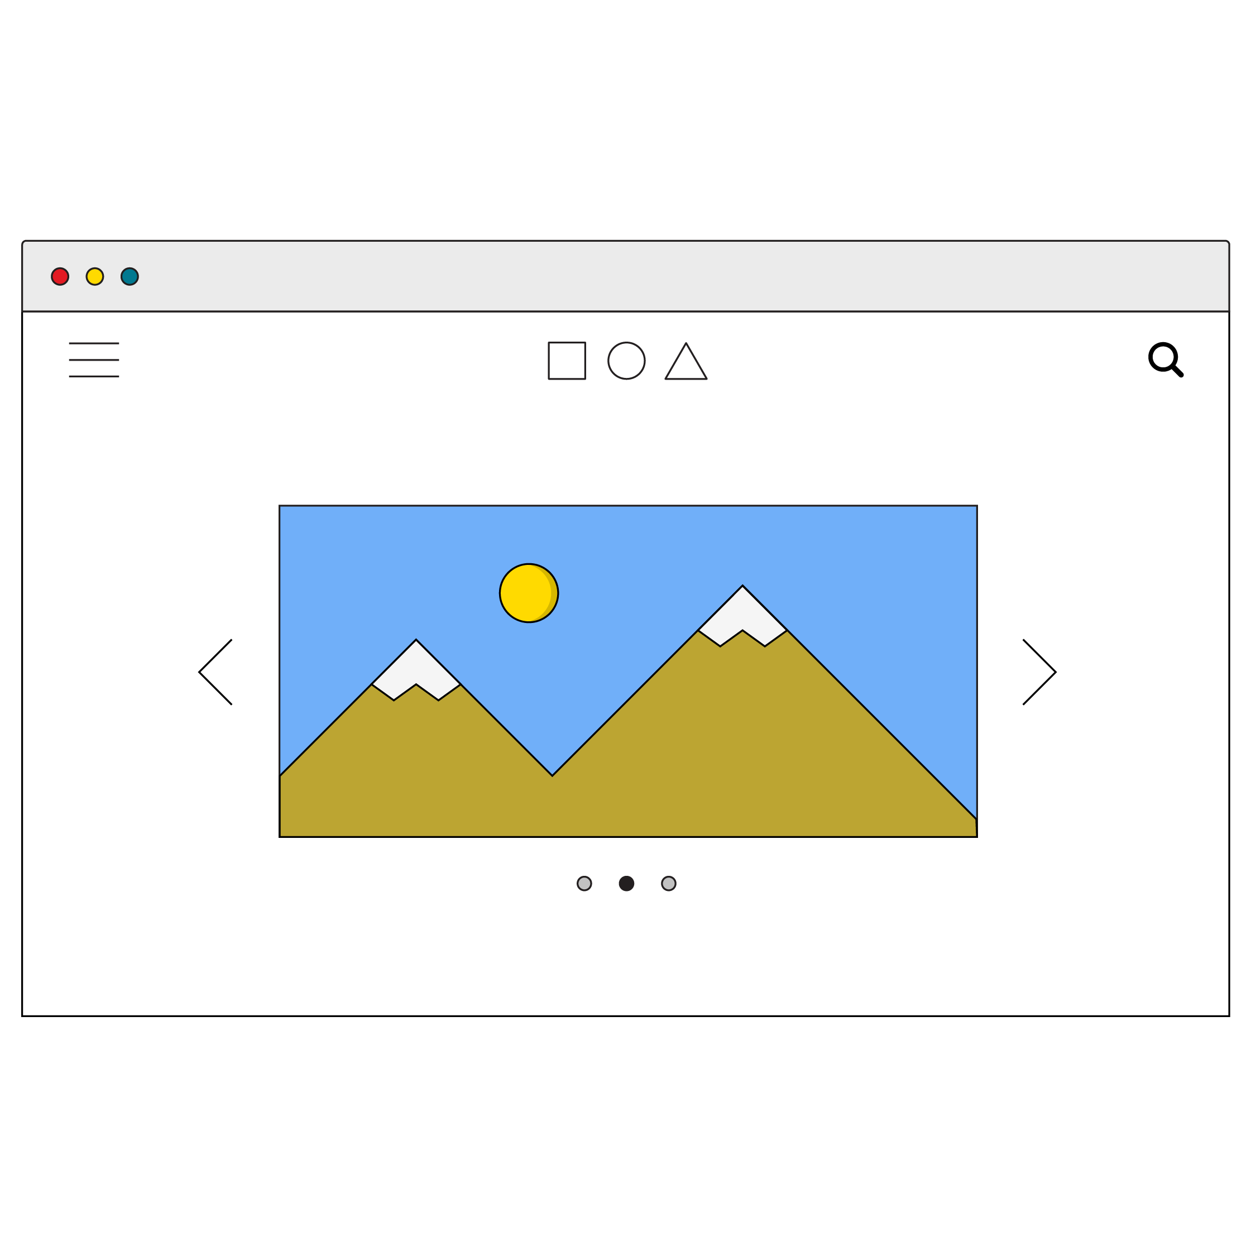

Welcome to the Neighborhood!
APIs, or application programming interfaces, are data sources that can give you access to information from all sorts of places on the internet. In this case an API is a data interface on a server that receives requests and returns responses.
Request
API
Response

Slide 8
Uses of APIs
So, what kind of data do APIs serve up? It’d be difficult to find any kind of data that doesn’t have an API. Common uses are Google Maps plugins, social media integration, and payment APIs for handling customer purchases.
You can even use Google’s Firebase API as your own customizable database for storing any data your applications might need!
An exhaustive list of public APIs can be found here: https://github.com/public-apis/public-apis
Notes:
TEACHING TIPS:
Feel free to open that link and browse through the enormous list of APIs so students understand that there are APIs for nearly everything!

Slide 9
Fetching Data
Front-End Web Development

Slide 10
APIs Sound Great! How Do I Get Started?
APIs work on a request-response cycle, so our first step is to make a request. API requests use the HTTP protocol, meaning we’ll need to use a URL address.
Port
Query
http://www.domain.com:1234/path/to/resource?a=b&x=y
Protocol
Host
Resource path

Slide 11
Asynchronous Code With Async/Await
API calls are asynchronous code. Because we have no idea how long the response will take to return, we have to await the result. We can do so using two keywords that come as a pair: async and await.
async function askForData(){
const response = await fetch(url);
const data = await response.json();
}
Notes:
TEACHING TIPS:
Feel free to get as involved with the behind-the-scenes workings as possible, such as showing alternative versions of handling promises in JS. However, this is historically the cleanest and clearest way of getting the job done.

Slide 12

Fetching Data With fetch()
Once you have an address, you can send a request using JavaScript’s built-in fetch() method, which accepts the destination URL as a parameter and returns a promise.
Promises are a proxy for a value that has not returned yet… but is on its way! This code is asynchronous, so we use async & await.
const response = await fetch(url);

Slide 13
Evaluating APIs
Front-End Web Development

Slide 14
Read the Docs!
Every API is unique — you will have to explore its documentation to figure out what data you want to access and what URL to use in order to send requests. However, there are a few standard details to check for in any API:
Do I need an API key?
If so, are there rate limits or charges for requests?
How do I include the key in my requests?
What are the available endpoints for data?
What URL format can search for specific data?
What will the response data look like?
Typically the response will be JSON.

Slide 15
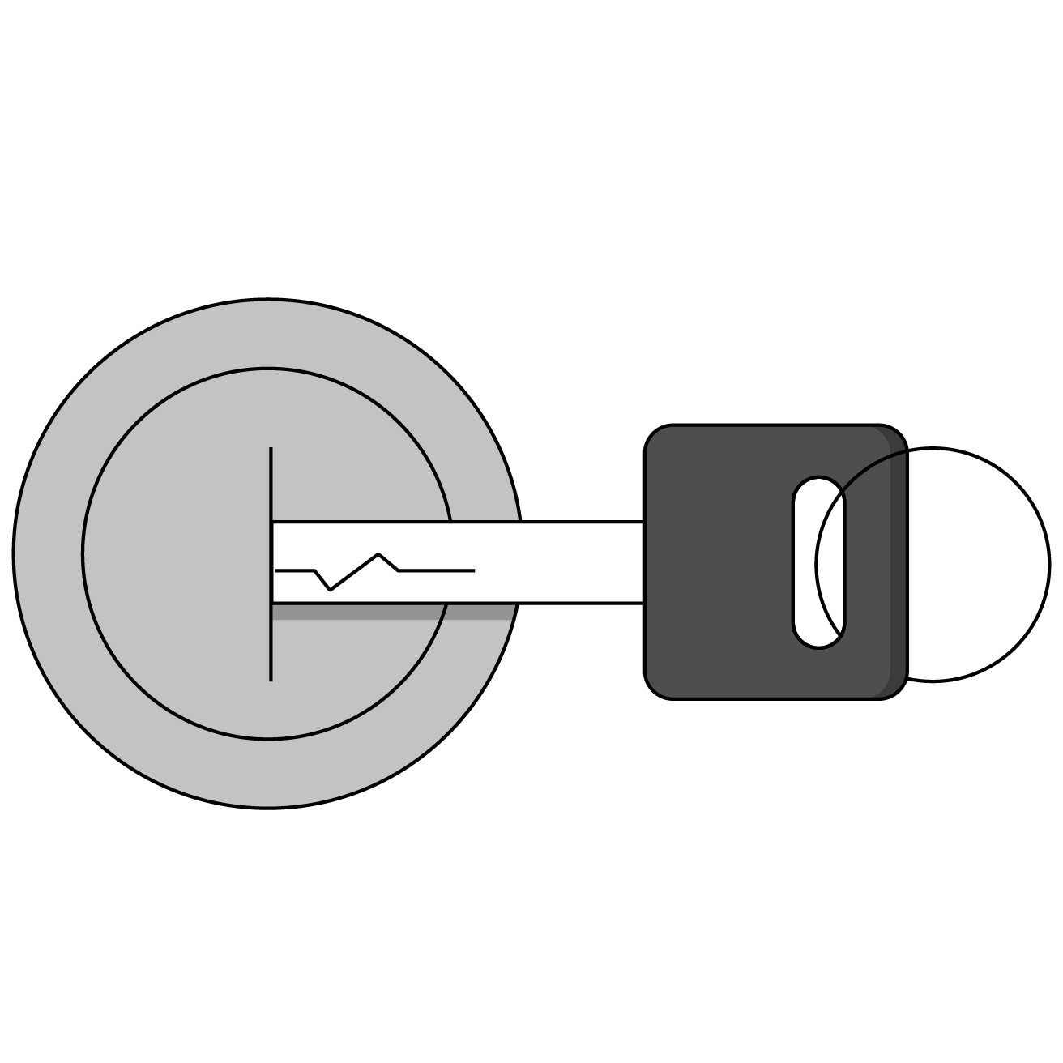
API Keys
Many APIs require you to include a key with your request.
You can register with the API’s website to receive your unique key.
Keys are used to track your requests for rate limits and potential charges. Don’t worry, most APIs have a free tier!

Slide 16

JS Objects
API endpoints will almost always return JSON in the form of an object.
{
“data”: “car”,
“make”: “ford”,
“model”: “focus”
“details”: {
“color” : “blue”,
“mileage” : “54019”
}
}

Slide 17
Many-Layered Objects
API response objects are infamously complex in their formats. To dig down to the layer of information you actually want, carefully log one layer at a time until you reach the data you’re looking for!
const carData = {
“data”: “car”,
“make”: “ford”,
“model”: “focus”
“details”: {
“color” : “blue”,
“mileage” : “54019”
}
};
console.log(carData);
console.log(carData.details);
console.log(carData.details.color);
Notes:
TEACHING TIPS:
You can also use the browser inspector for a convenient debugger-type object exploration environment.
It’s tough dealing with complex objects at first, so working one layer at a time is more testable and builds syntax skill.
You can log out the response object from the weather example to see how complex it can start as, and how commonly we need to chain properties to reach the goal.

Slide 18
Giphy Search
30 minutes
Where would the internet be without GIFs? Use the giphy.com API to create a GIF search application using your new API skills!
Starter code:
https://drive.google.com/drive/folders/1tsBq4Vxud86DDvyMILe-ynt71ZQjqgvZ?usp=sharing
Notes:
TEACHING TIPS:
This should be tough but very fulfilling. Students may need to open up the console to see the large response object. Encourage them to read the documentation, test small pieces, and be resilient! You may need to guide them through it at key points.

Slide 19
Weather API
Let’s create a weather app together!
Starter code:
https://drive.google.com/drive/folders/143GU3jH8DchB-IuXZSvTmZIUtsWMXsM9?usp=sharing
Notes:
TEACHING TIPS:
Refer back to this example throughout the steps of API usage in order to ground the concepts in a concrete scenario.

